Slide 1
Nebula NEST
Connecting Dreams, Building Homes: Your Journey to Buy or Sell Starts with Nebula Nest.

Slide 2
Project summary Project Title: Nebula Nest Project Description: Connecting Dreams, Building Homes: Your Journey to Buy or Sell Starts with Nebula Nest. Our Team: Hemalatha Carolin Palaparthi (Chief Programmer and Designer) Sai Pranith Patibandla (Developer & Tester)

Slide 3
TABLE OF CONTENTS
01
Problem statement
02
Solution
03
KEY FEATURES
04
UML DIAGRAM
05
CODING
06
TESTING

Slide 4
01
PROBLEM STATEMENT

Slide 5
Problem statement
The existing real estate transaction landscape is burdened by complexities, involving multiple intermediaries, intricate paperwork, and a lack of transparency.
This results in a protracted and often frustrating experience for both property buyers and sellers.
Inefficiencies in the real estate market led to delayed transactions, increased costs, and a deficit of trust among involved parties.
There is a discernible need for a centralized, intuitive, and transparent platform that facilitates property transactions.

Slide 6
Price is what you pay, value is what you get.
–Warren Buffett

Slide 7
02
SOLUTION

Slide 8
SOLUTION
The proposed Nebula Nest Platform aims to revolutionize the real estate market by addressing key challenges.
It features a centralized property database for easy access, streamlined transaction processes with user-friendly interfaces, and transparency through accurate listings and historical data.
The platform also includes a marketplace connecting users with service providers and implements robust security measures.
By offering educational resources and responsive customer support, the platform seeks to create a seamless and trustworthy real estate experience for all stakeholders.

Slide 9
03
KEY FEATURES

Slide 10
KEY FEATURES
Buyer Addition
Seller addition
ADMIN addition
Buyer Registration Buyer Login
Seller Registration Seller Login
Admin Registration Admin Login
Buyer dashboard
Seller dashboard
Admin dashboard
Buyer can list the property willing to buy by placing an order with details like location, price, etc.
Seller can list the property willing to sell by placing an order with details like location, price, etc.
Admin can watch all the properties of buyers and sellers

Slide 11
KEY FEATURES
Firstly user registers as buyer or seller.
Then user login with their credentials.
User will be moved to dashboard based on his role like buyer, seller or admin.
If user has properties, they can see all of them in the dashboard.
If the user is buyer or seller then they can list the property by adding the card.
User can add , modify or delete the property.

Slide 12
04
UML DIAGRAM

Slide 13
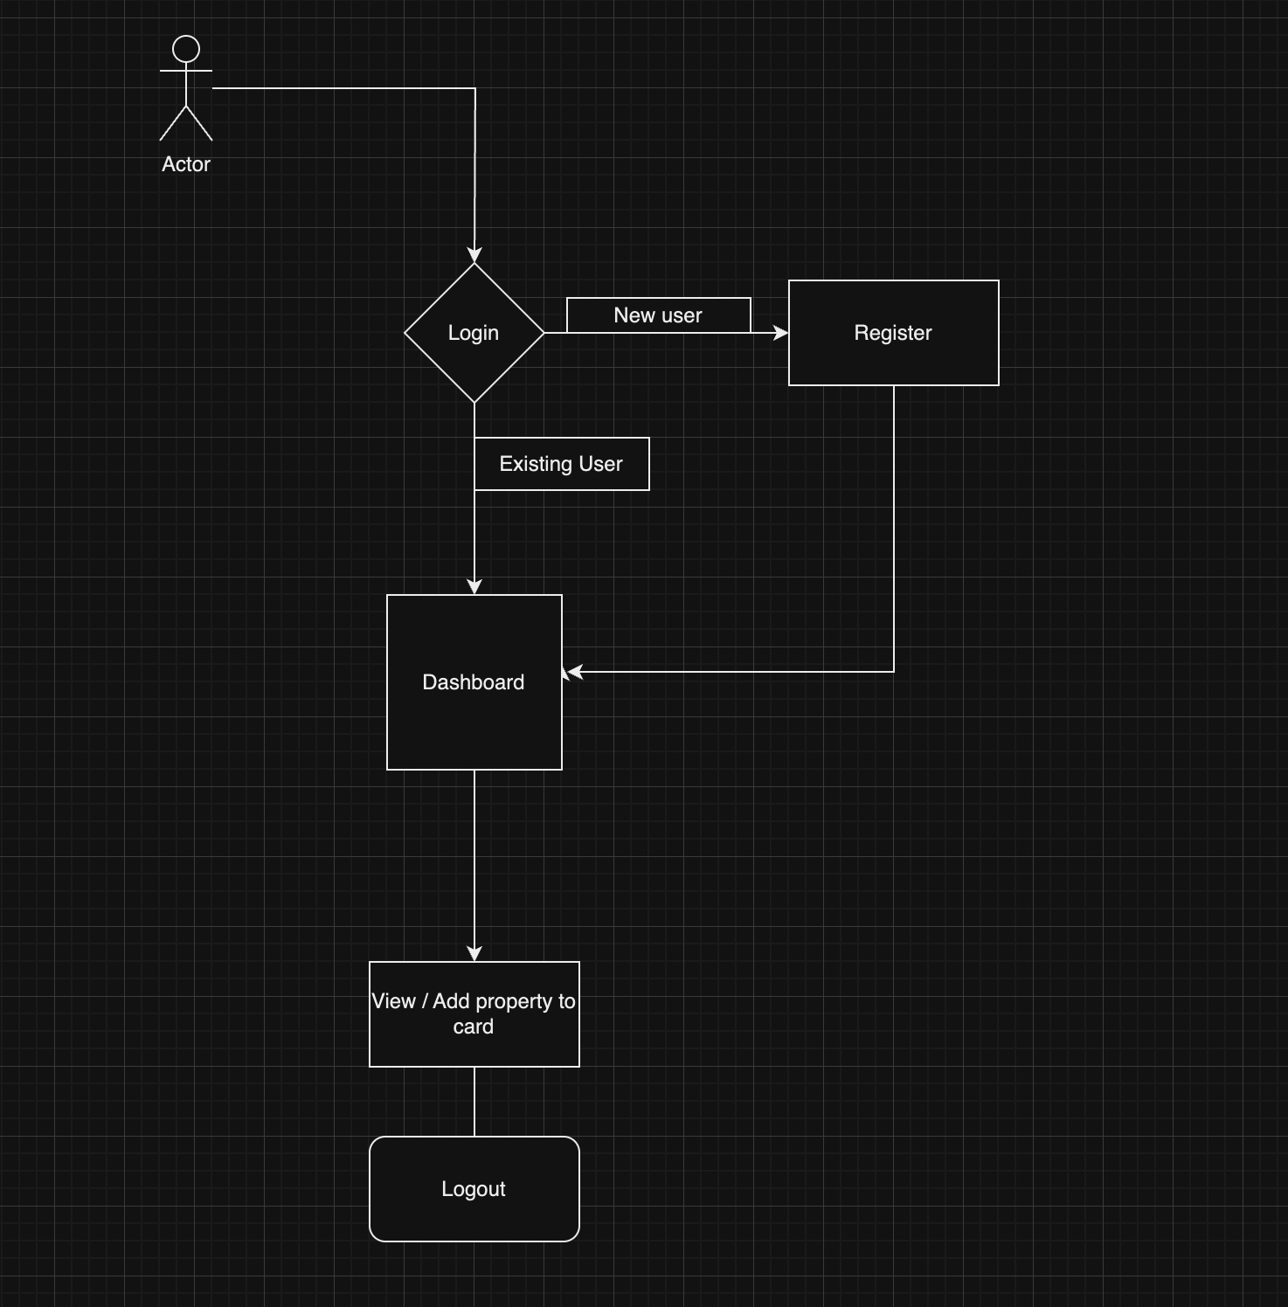

Slide 14
05
CODING

Slide 15
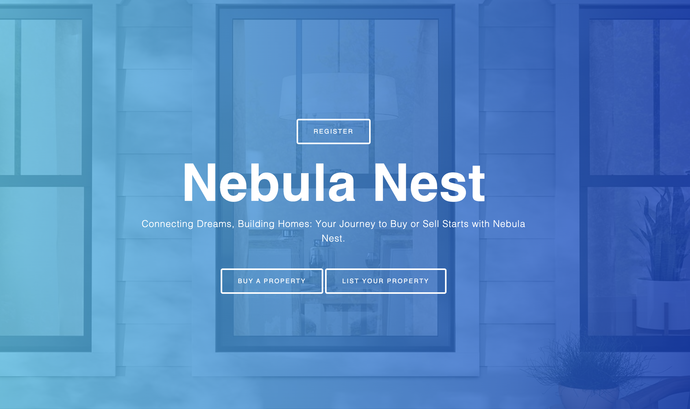
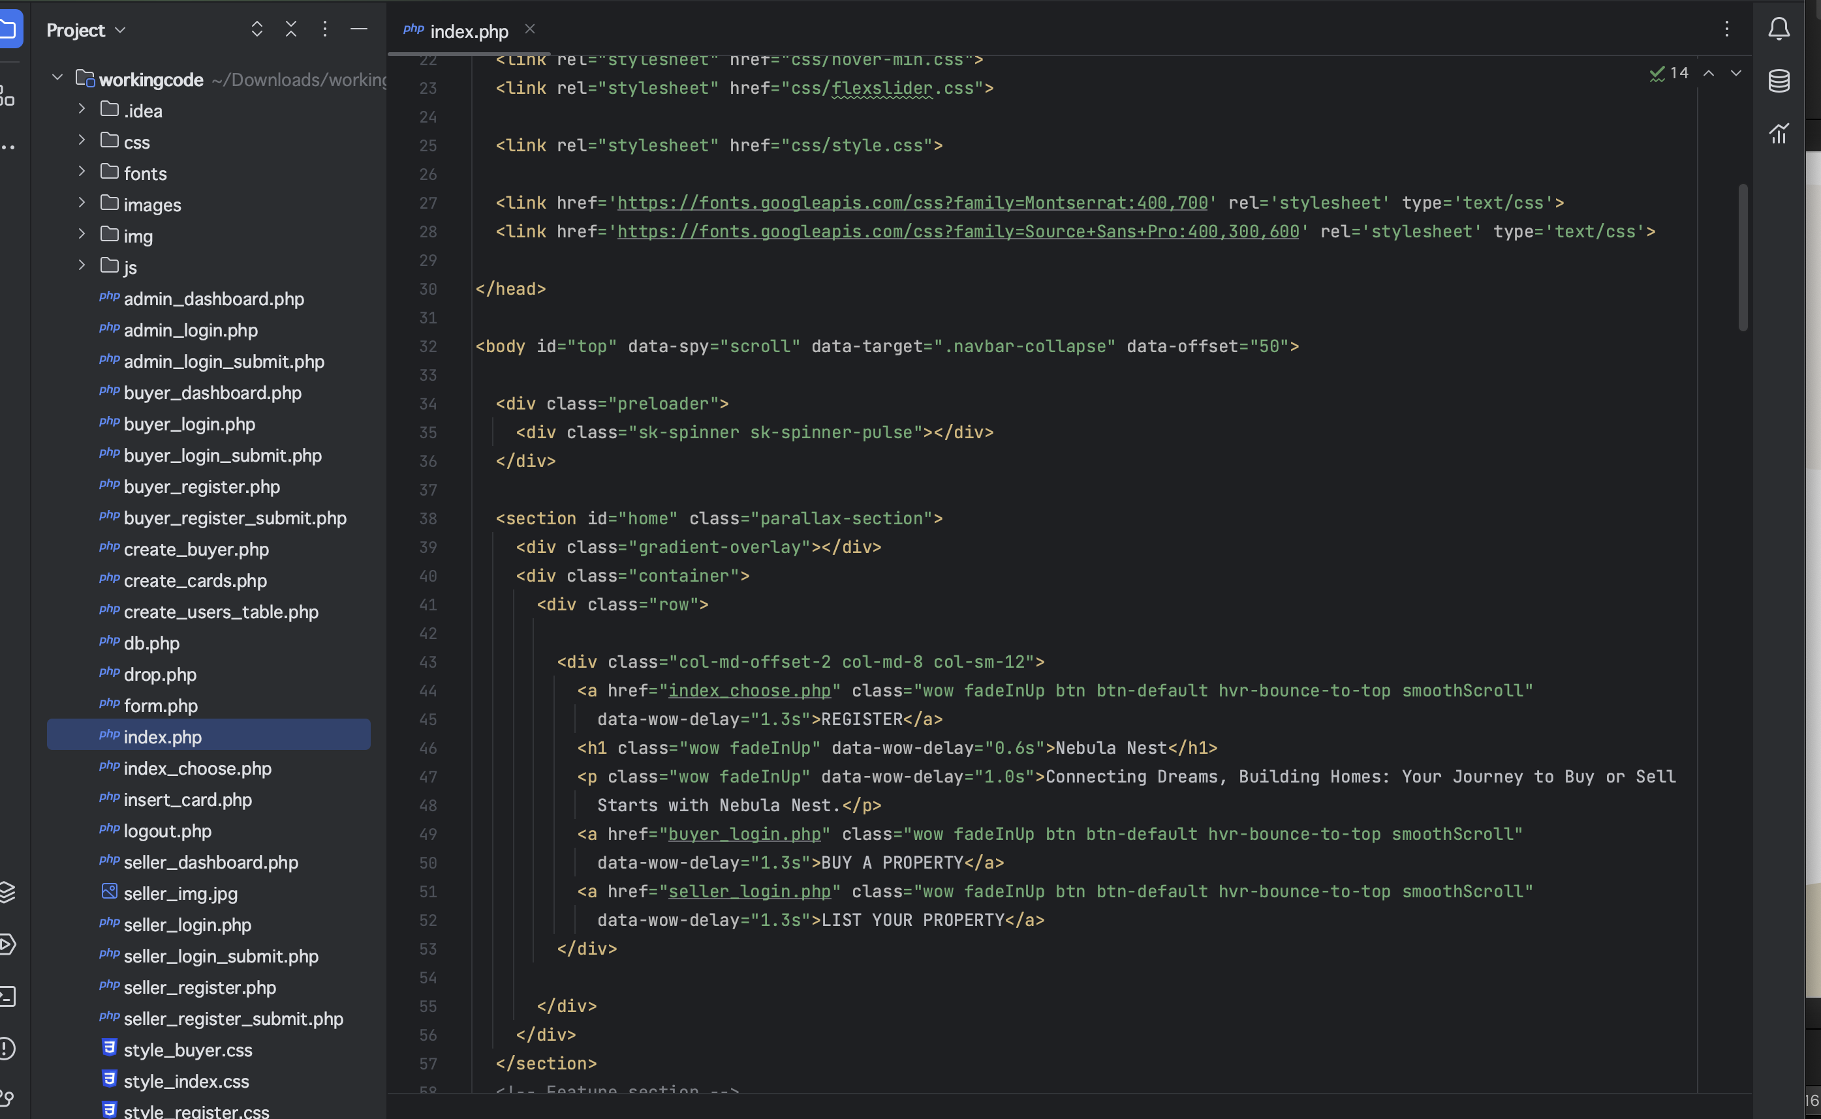
Home

Slide 16
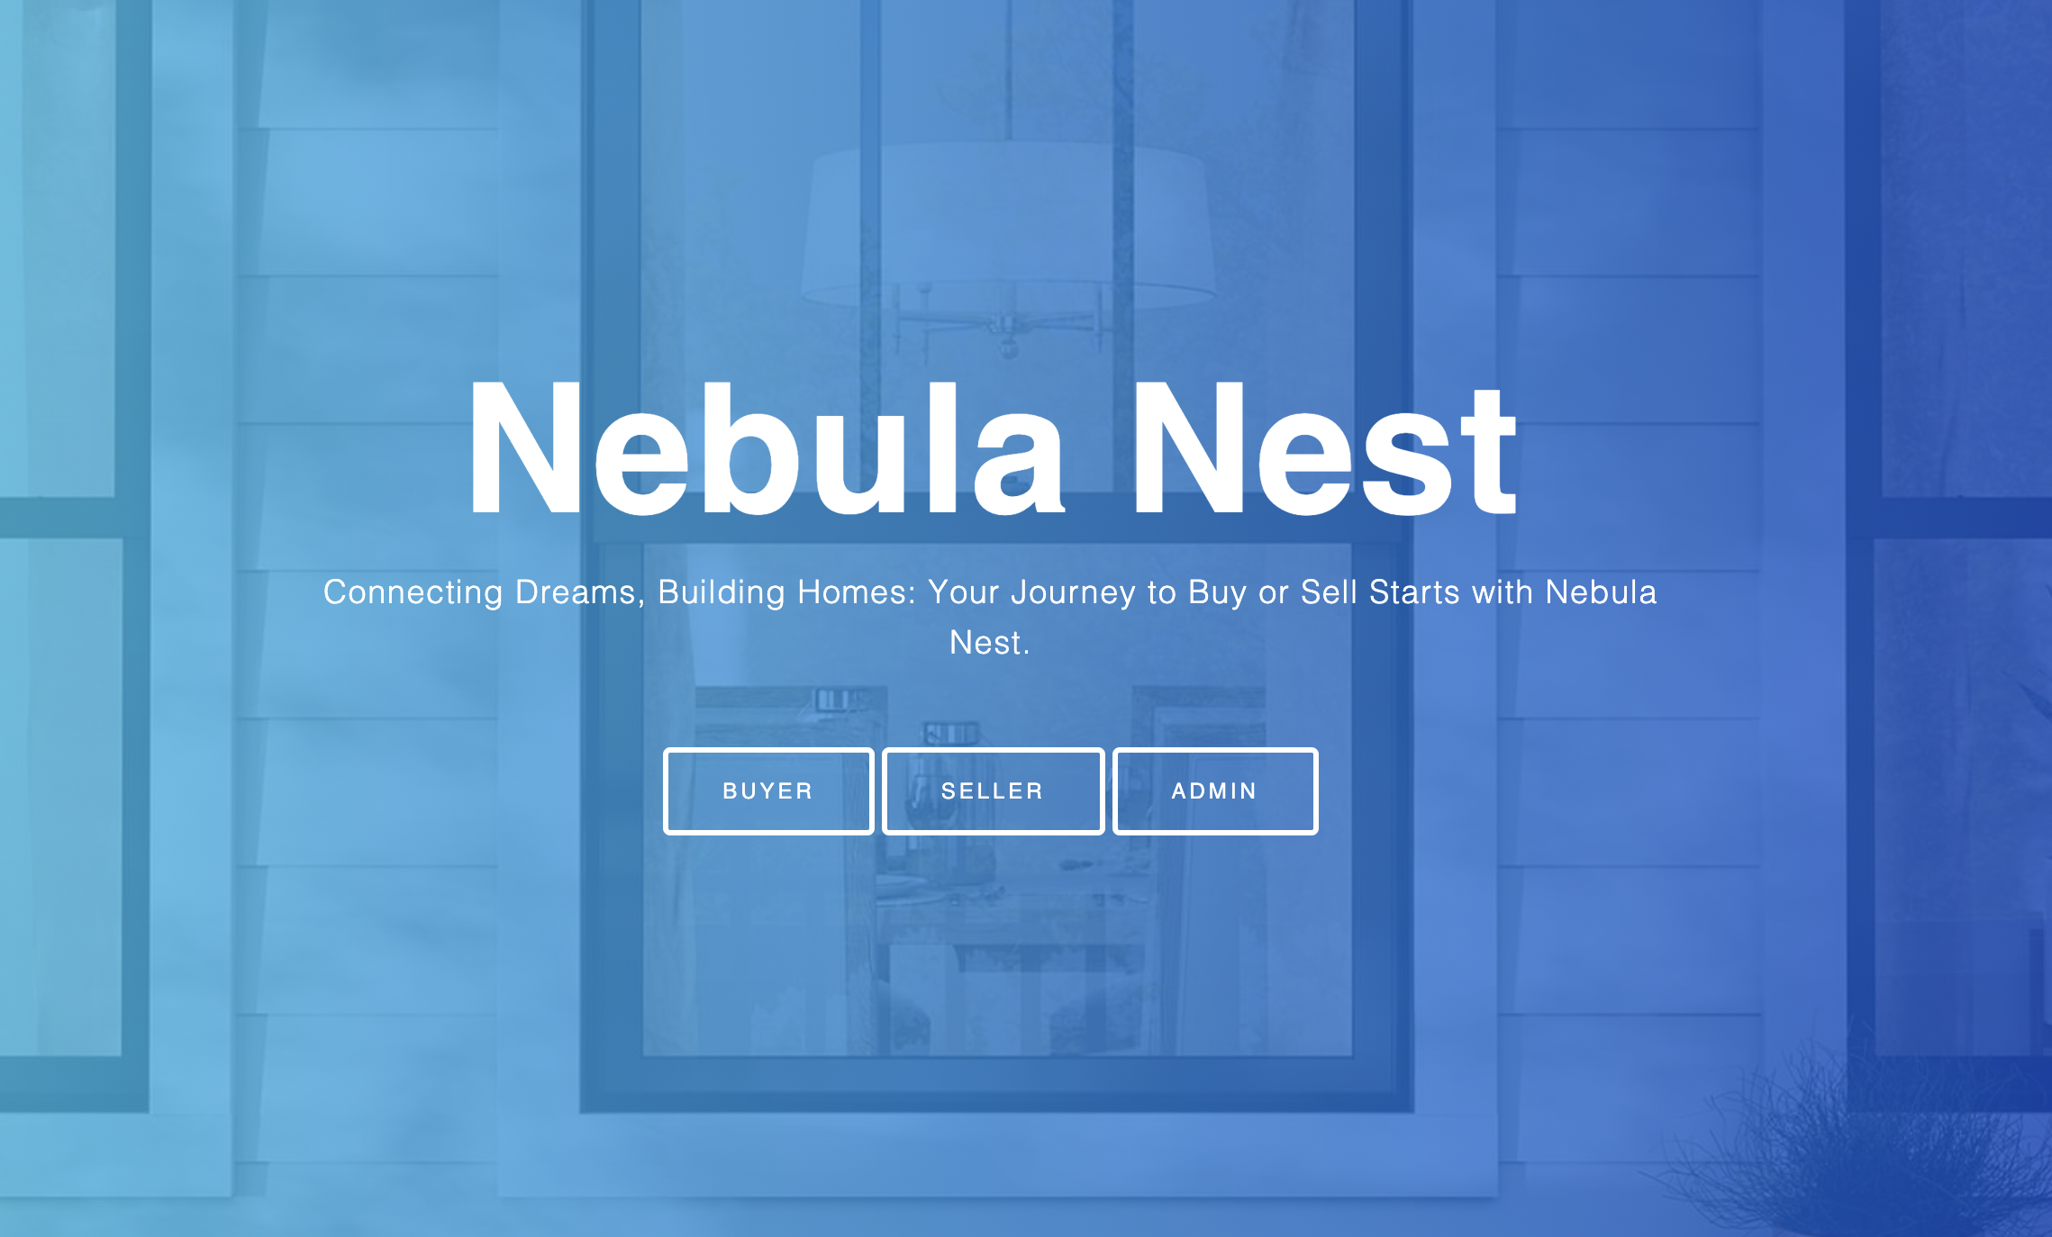
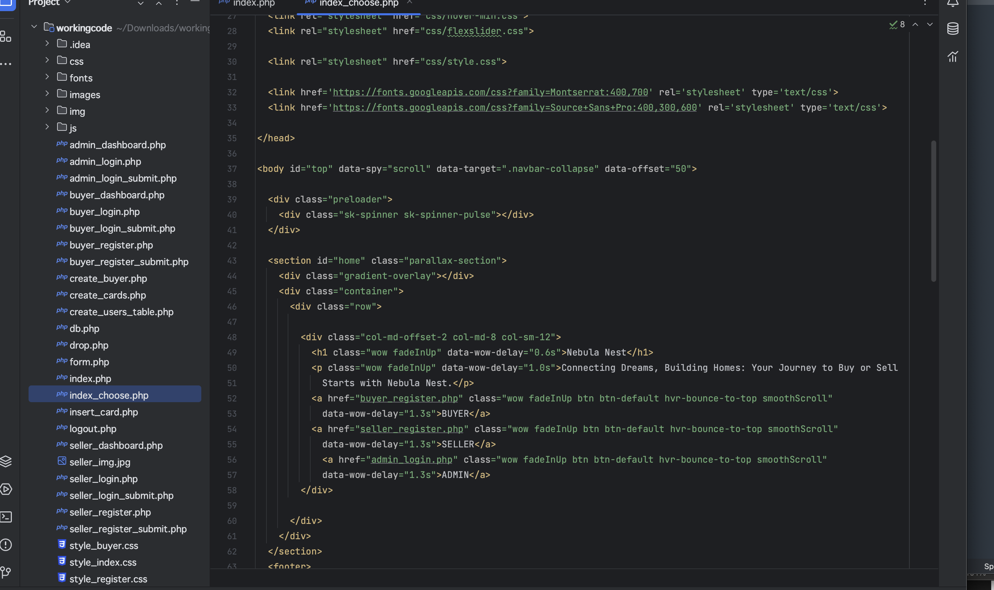
INDEX choose

Slide 17
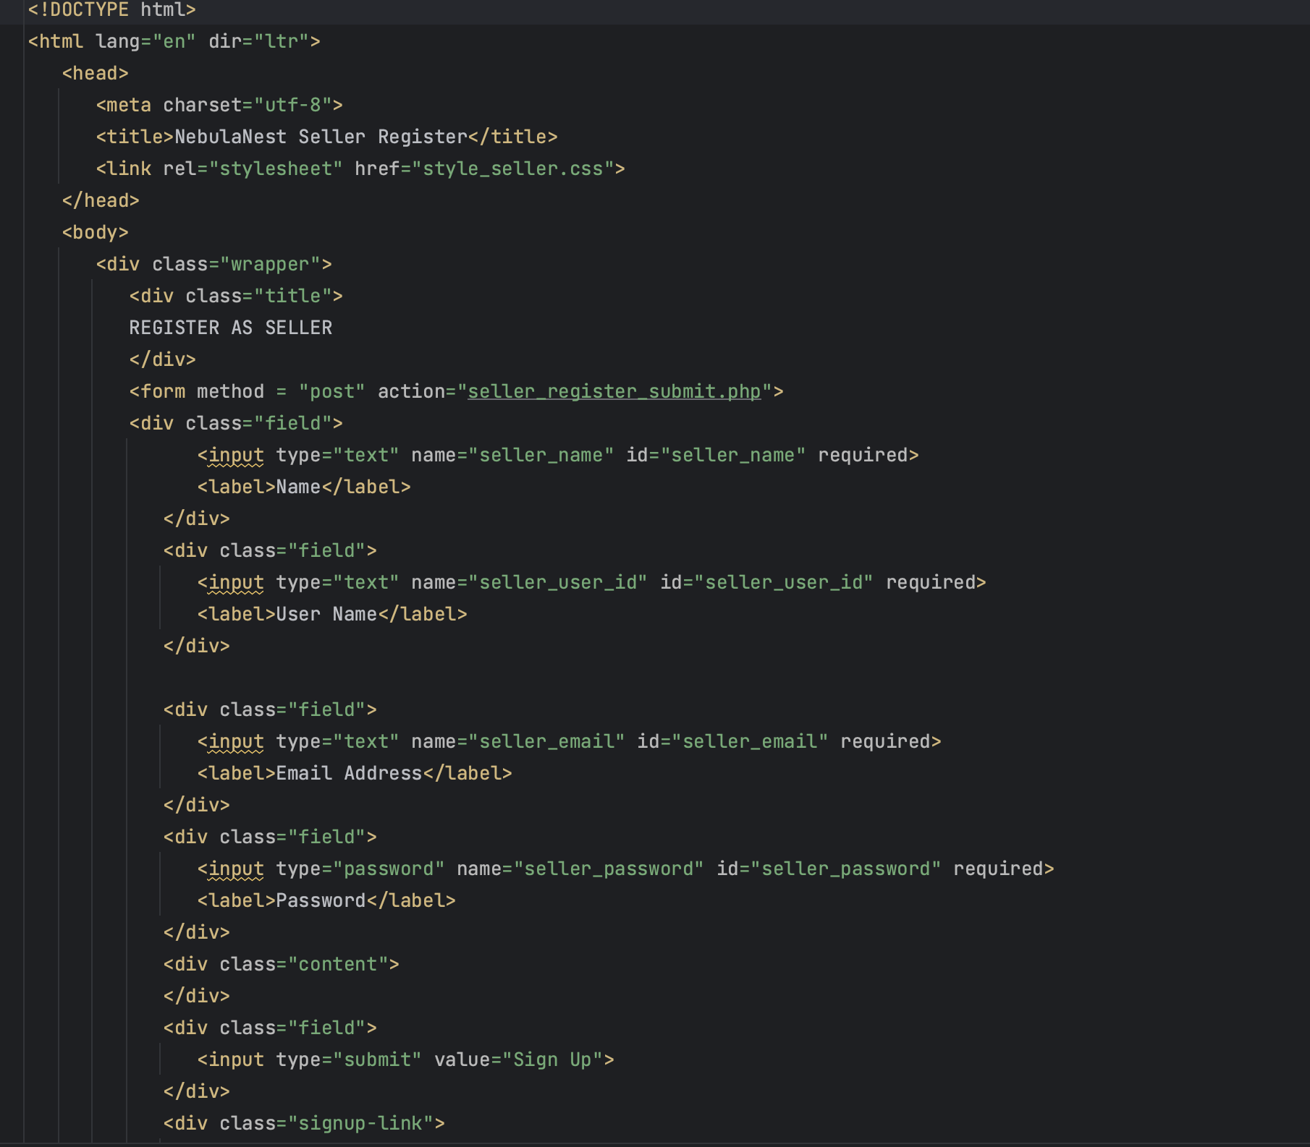
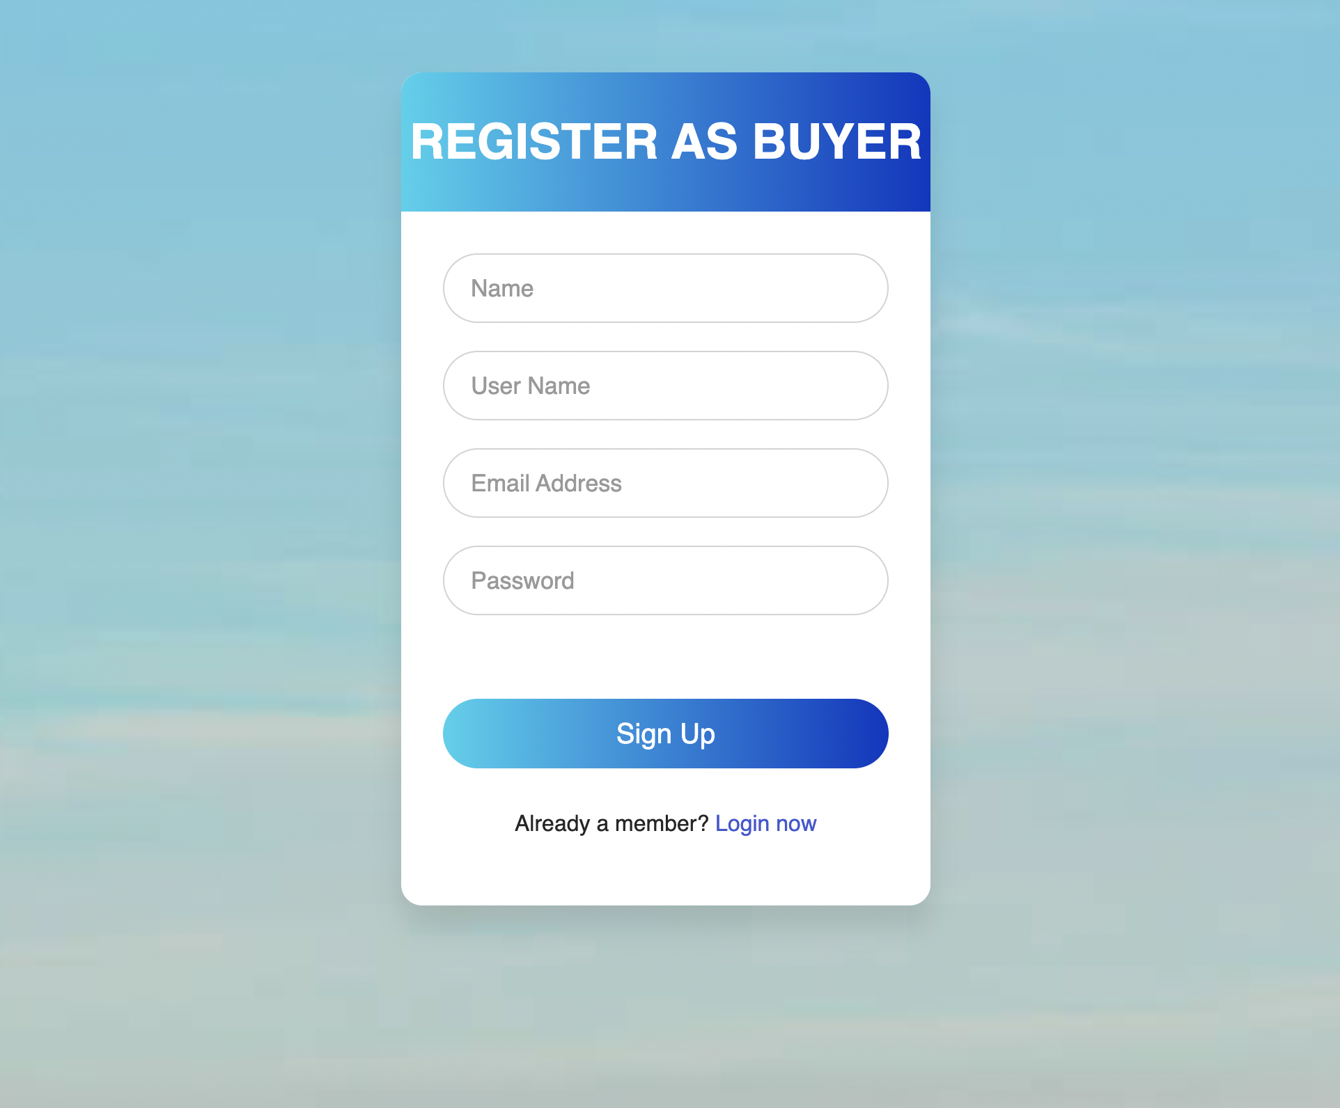
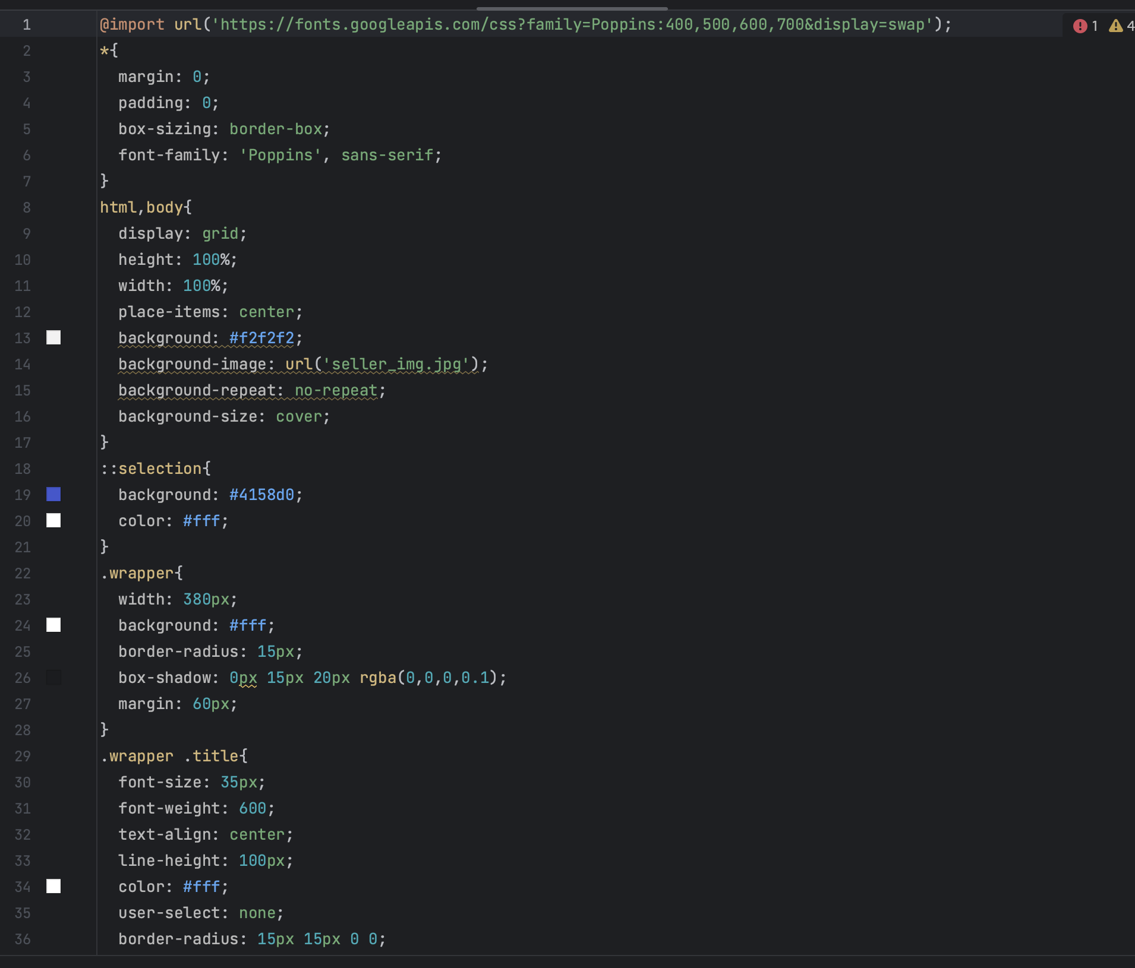
REGISTER

Slide 18
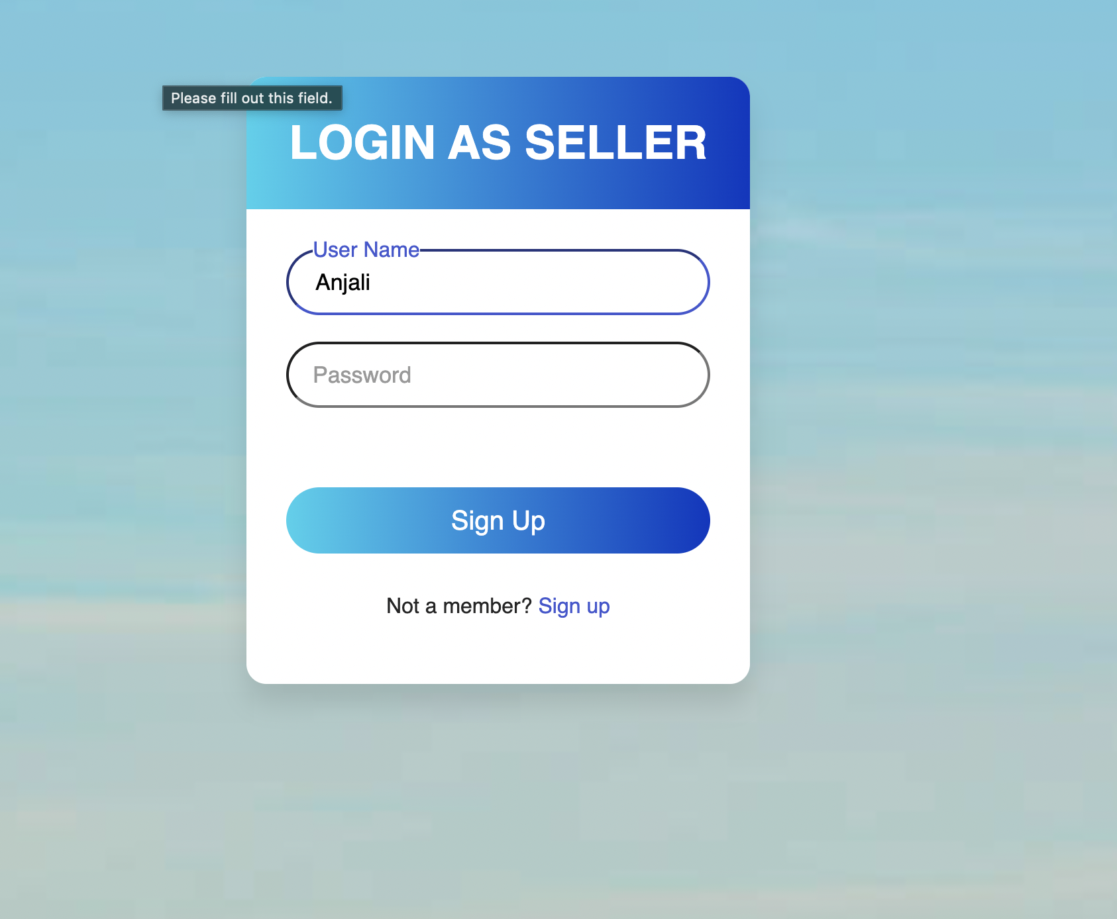
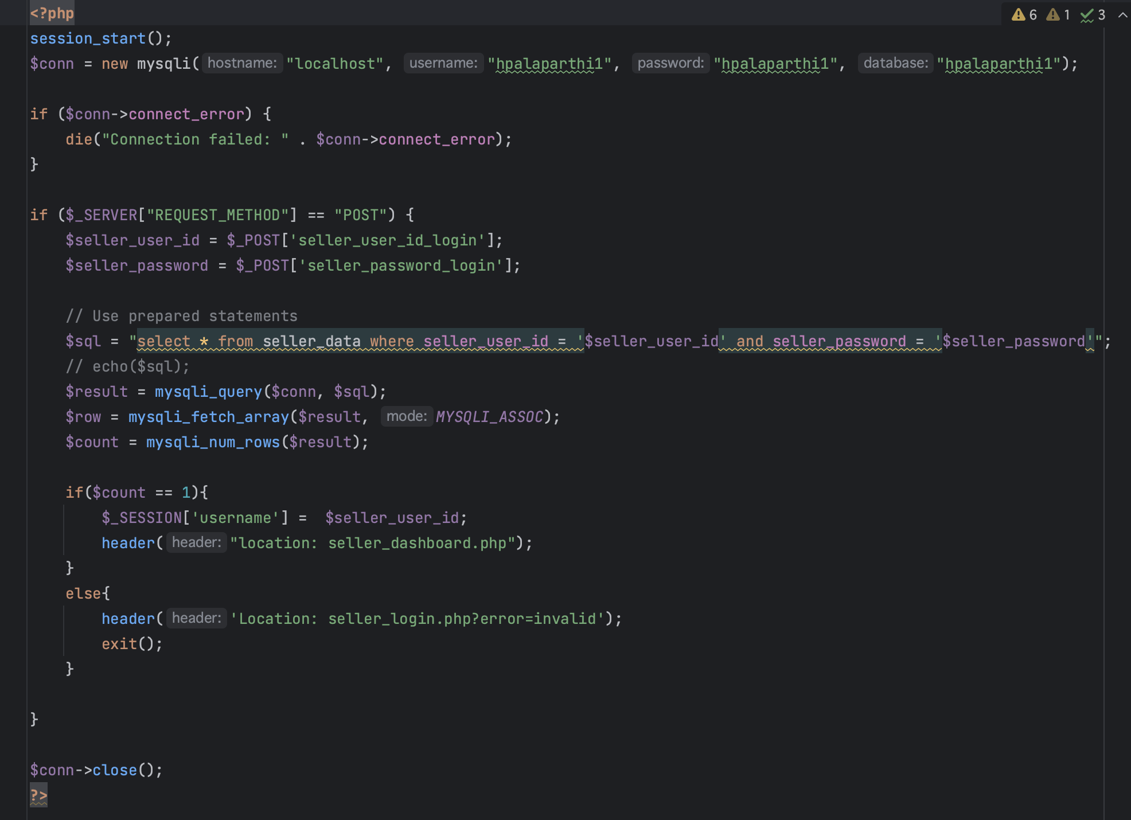
LOGIN

Slide 19
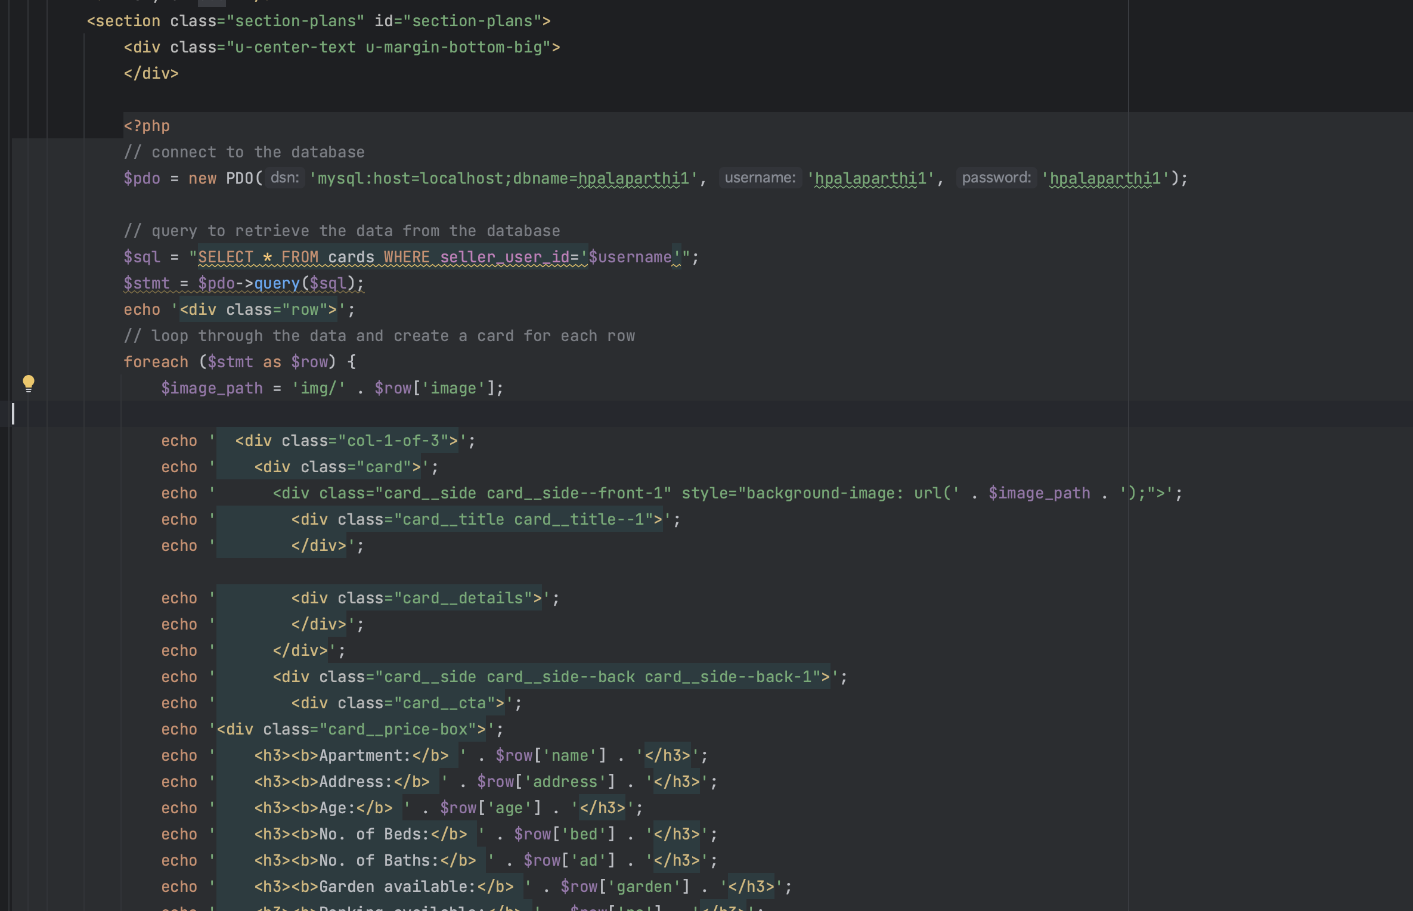
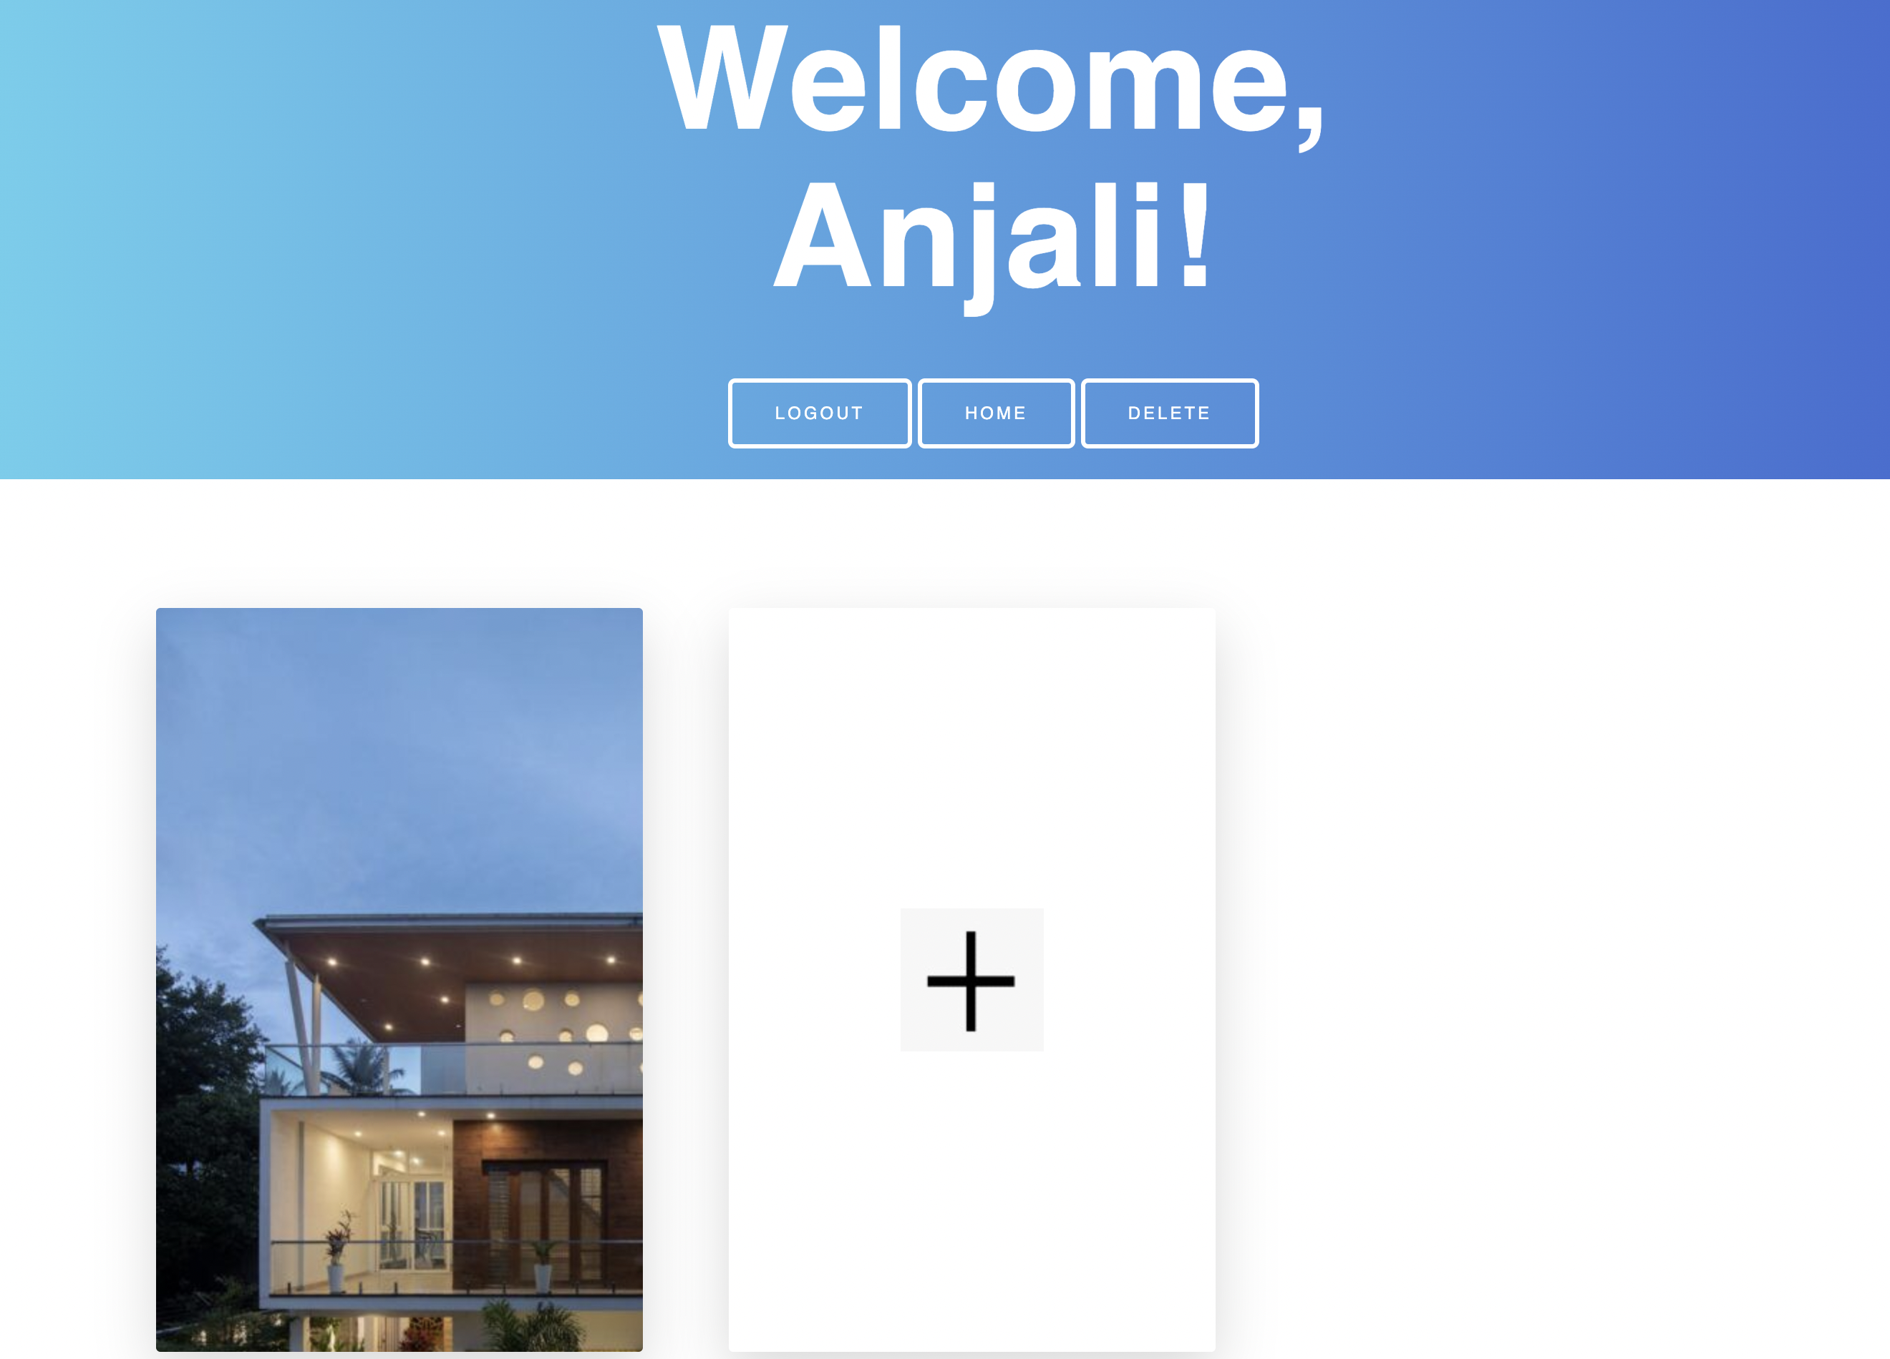
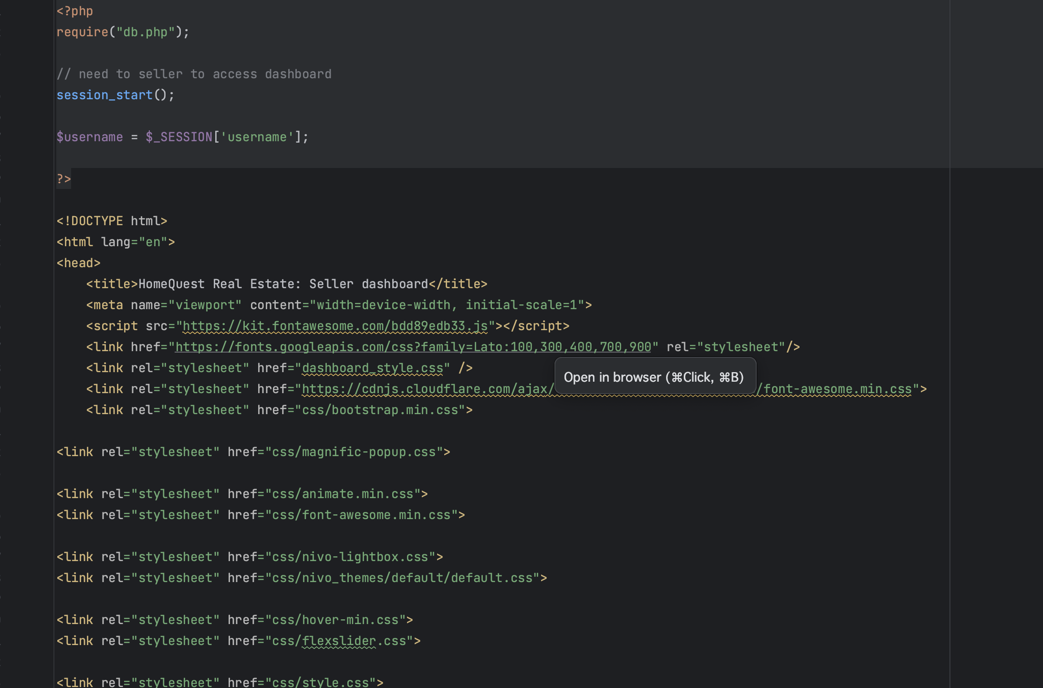
Dashboard

Slide 20
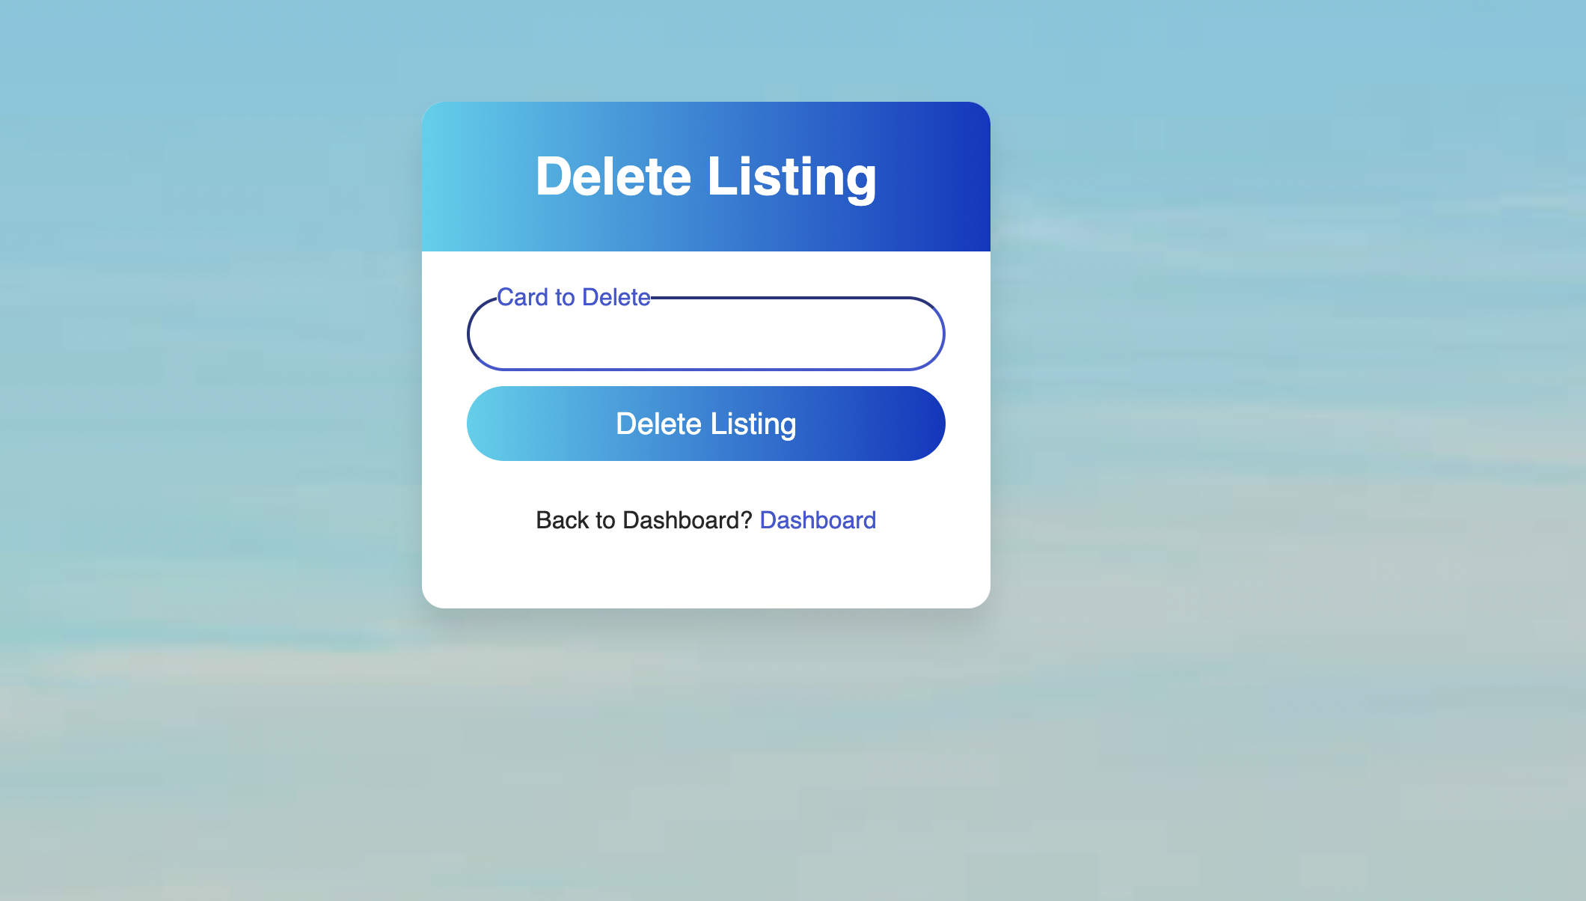
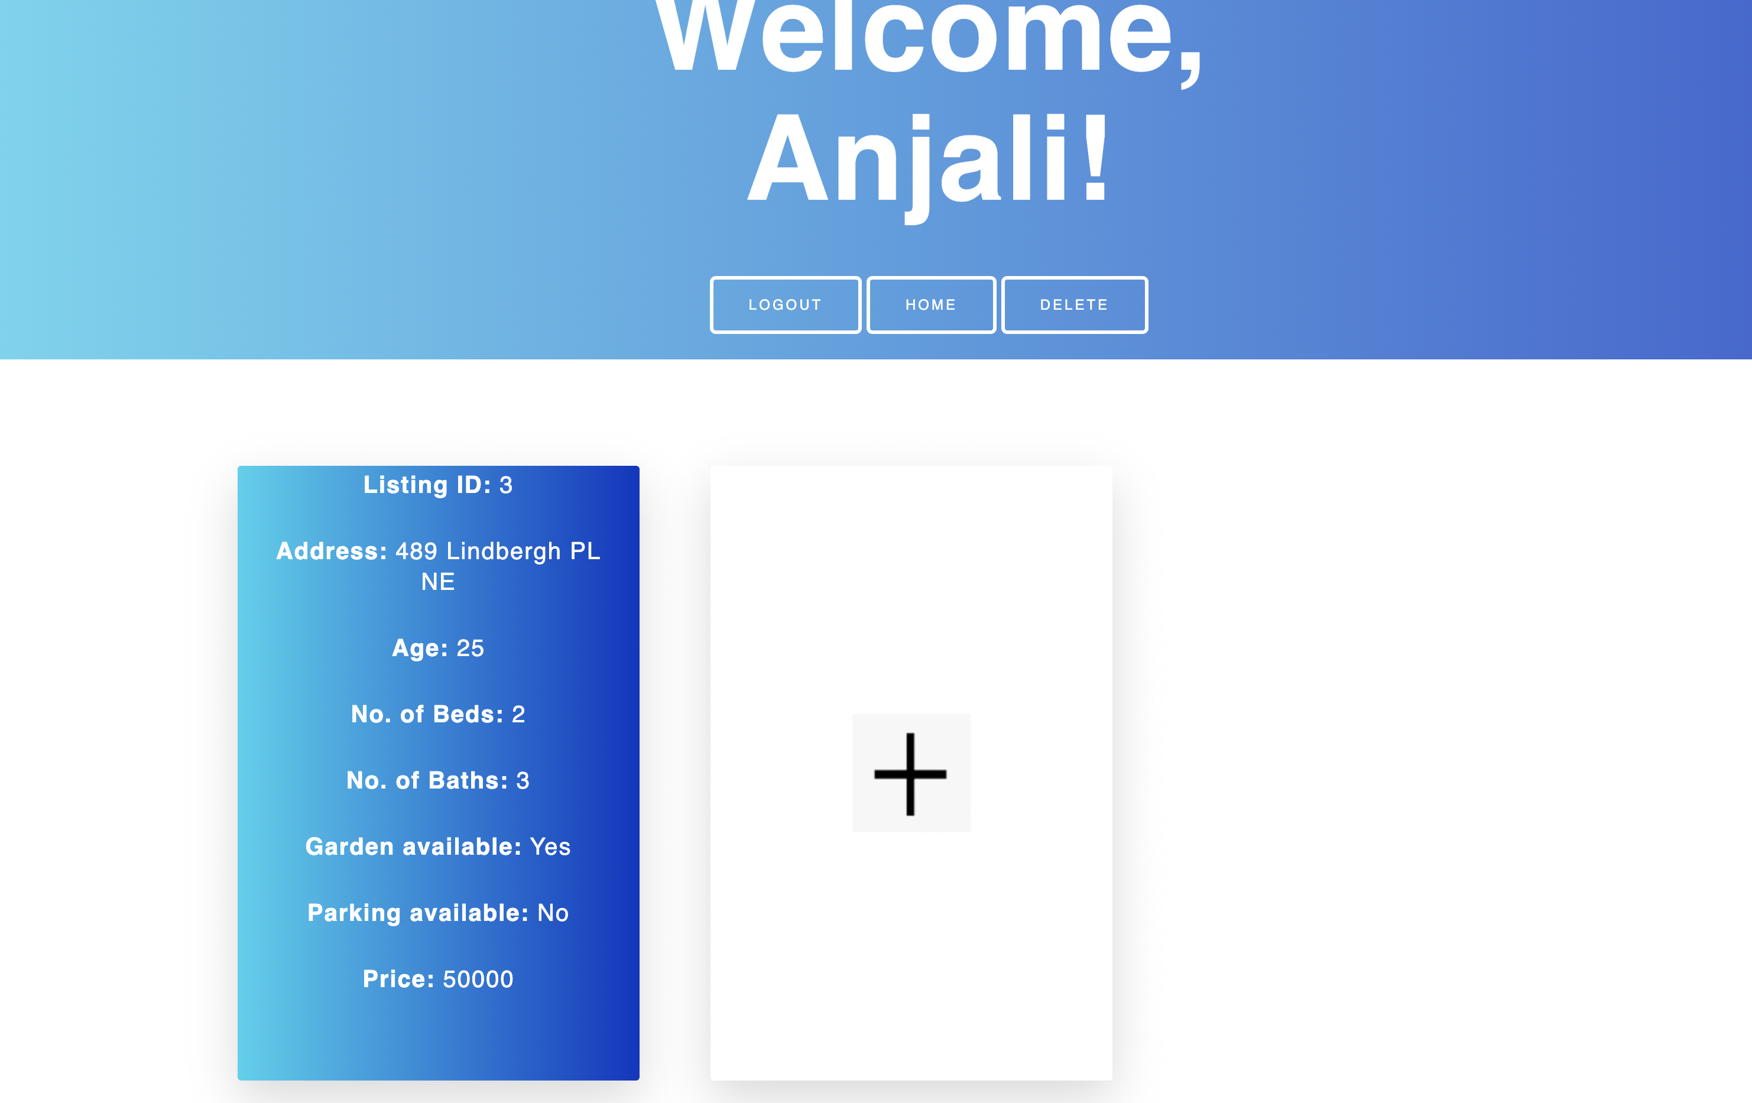
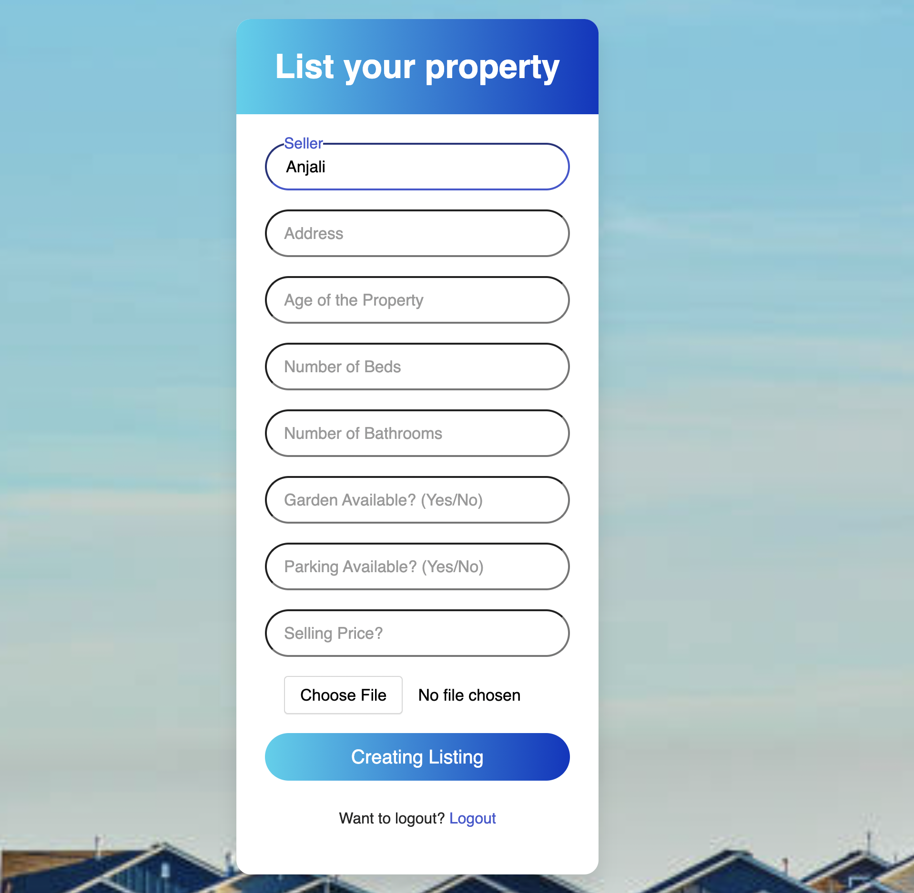
Dashboard

Slide 21
07
TESTING

Slide 22
TESTING
USABILITY TESTING
Cross-browser and cross device testing
Functional testing
Validation testing

Slide 23
REVIEW – KANBAN METHODOLOGY
Visualize the work
Limit the work in progress
FOCUS and flow
We kept the work items into an easy-to-read visuals using sticky notes.
We bound to agile methodology the keeping track of work in progress.
Continous improvement
We managed the quality and quantity of work by focusing on other
activities as well.
We used plan–do–check–act. It is an iterative design and management
method used in business for the control and continual improvement of
processes and products.

Slide 24
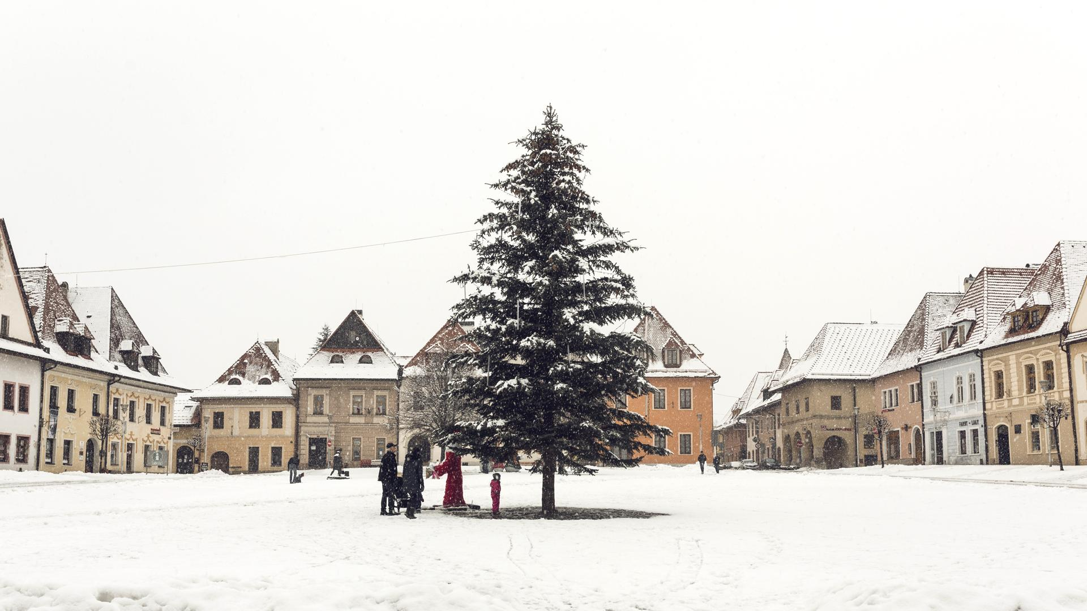
DEMO

Slide 25
Thank You !!

